Slide 2

About telecom churn prediction
8
Data Cleaning & Preprocessing
4
Our Mission and Vision
ML Model Building
5
Our Goals
10
Hyperparameter Tuning
6
Our Milestones
11
SVM & Confusion Matrix
7
Challenges
13
Conclusion

Slide 3





















re i
"Telecom Churn Prediction" aims to empower telecom companies with actionable insights and tools to reduce churn, retain customers, and improve overall business performance in a highly competitive telecommunications market.
Back to Agenda

Slide 4







Mission
Vision
Telecom churn prediction contributes to the overall success and competitiveness of telecom companies in a rapidly evolving market landscape.
Telecom churn prediction can drive significant Improvements nn customer satisfaction, business performance, and competitiveness within the telecommunications sector.
Back to Agenda

Slide 5




Minimize Churn Rate
Maximize Customer
Retention
Optimize Business
Performance
Back to Agenda

Slide 6

1st
2nd
3rd
4th
Data gathering & understanding the dataset.
Data Cleaning and Pre-processing.
Machine Learning
model building.
Hyperparameter Tuning, SVM & Confusion Matrix
Back to Agenda

Slide 7

Challenges :
Data Quality and Integration: Telecom companies oñen have vast amounts of data stored across multiple systems, including customer demographics, call logs, usage patterns, and billing information. Integrating and cleansing this data for analysis can be challenging, and poor data quality can lead to inaccurate predictions.
Imbalanced Data: Telecom datasets are oñen imbalanced, with a small percentage of customers churning compared
to those who remain. Imbalanced data can bias predictive models and lead to inaccurate churn predictions.
Dynamic Customer Behavior: Customer behavior and preferences evolve over time, making it challenging to build
accurate predictive models that adapt to changing patterns and trends.
Scalability: Telecom companies serve large customer bases, and churn prediction systems must be scalable to handle
massive volumes of data and real-time predictions.
Real-Time Prediction: Implementing real-time churn prediction systems that can provide timely interventions to
prevent churn is challenging due to the need for fast data processing and decision-making.

Slide 8




















re
m
essi
Convert datatypes of variables which are misclassiVned.
ensures accurate analysis and eNicient processing.
Removing duplicate records.
ensure accuracy, maintain integrity, and optimize eNiciency in data
management and analysis.
Removing unique value variables.
necessary to avoid redundancy, improve eNiciency, and ensure meaningful analysis.
Removing Zero variance variables.
necessary to eliminate redundant information, improve model stability,
and simplify interpretation.

Slide 9




















re
M
i
essi
Outlier Treatment.
necessary to maintain data integrity, improve model performance, and ensure robust and interpretable analyses.
Missing value Treatment.
essential for maintaining data integrity, improving model performance, and ensuring accurate and statistically valid analyses.
Removing the highly correlated variables.
necessary to reduce redundancy, improve model stability, and enhance eNiciency in model training and interpretation.
Multicollinearity (VIFx5).
crucial to ensure accurate, stable, and interpretable models.

Slide 10

























M
i
M
i
M M
i i
Logistic Regression
Decision Tree
Random Forest

Slide 11

Logistic Regression
Logistic regression is a type of supervised machine learning algorithm used for binary classiVncation problems, where the target variable is a binary outcome (0 or 1). It's an extension of linear regression, but instead of predicting a continuous value, it predicts the probability of the binary outcome.
Logistic regression is crucial for predicting binary outcomes, offering interpretable results, probabilistic predictions, efPnciency, and serving as a foundation for more complex models.

Slide 12


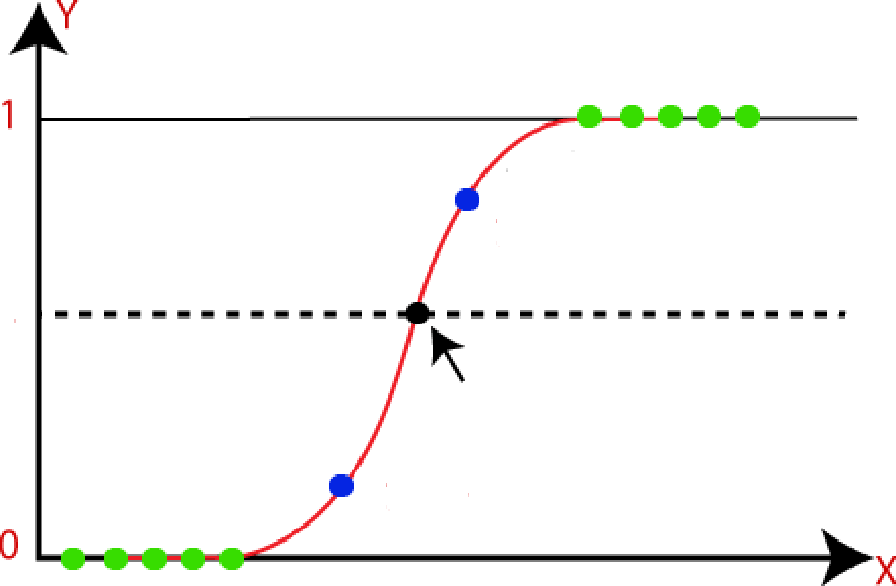




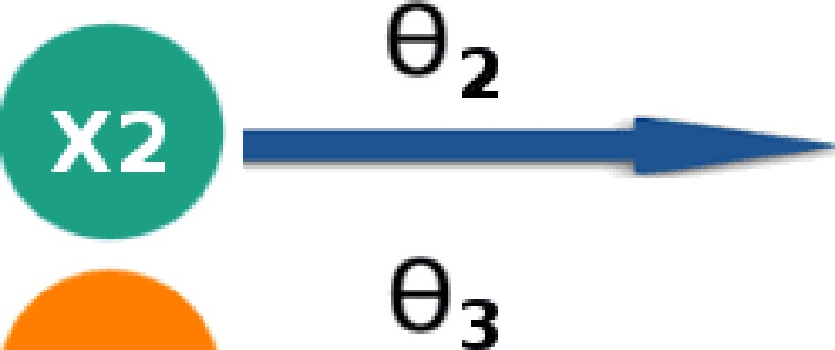


Pict res :
Logistic Regression Model
’k
—•••;$ S-Curve
y=0.8
Happy
0.5
Theshold Value
y=O.3
Inputs: XI, X2, X3 II ^eights: O-1, ^^. ^^ II Outputs: Happy or had

Slide 13
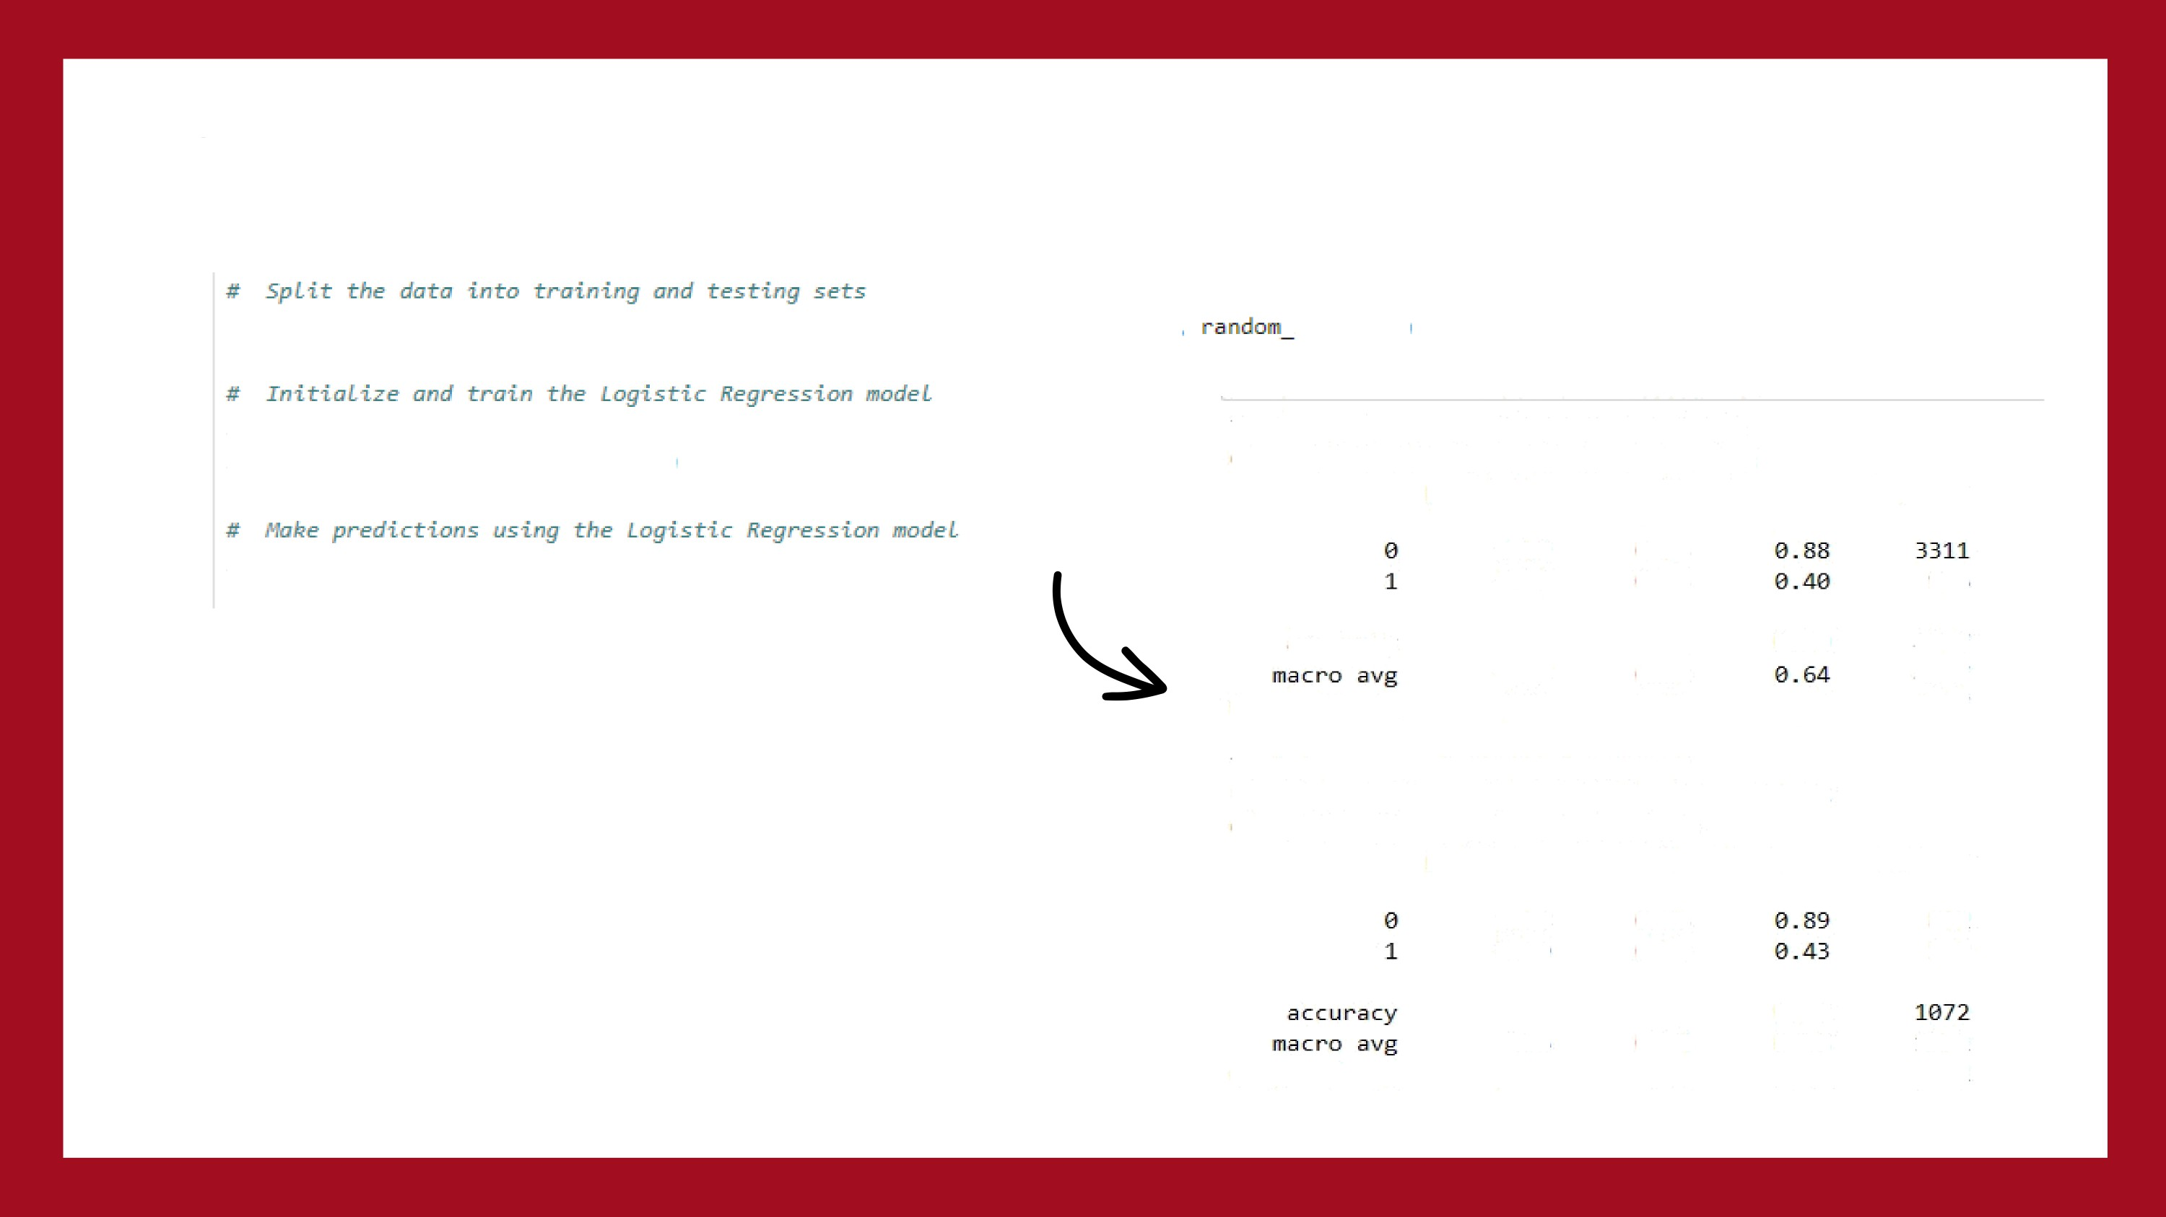

CODE SNIPPET
X_train, X_test, y_train, y_test = train_test_split(X, y, test_size .2,
state=42)
lo oR model = LogisticRegression(max_iter=lBB0, random_state Z)
logre model.fit(X_train, y_train)
Training Accuracy: 0.B02B924655936552
Chas s 1T1cat1on Repos (Tna1n1ng Dalam :
prec1s1on recall T1-score
su_{P}
lO oR
red = logre model.predict(X_test)
0.B2
0.66
B . 96
B. 28
976
accuracy
e.as
4287
6287
4287
0.74
B.62
6. B0
weighted avg
0.77
Test Accuracy: 0.8218283582089553
R Score (Test Data}:
Classification Report
-0.0572756377155B4304
(Test Data):
precision recall fl-score
support
0.B4
0.69
B. 96
B. 31
B4Z 230
0.76
0.B0
B.64
e.az
0.66
0.79
1072
1072
weighted avg

Slide 14
Decision Tree
Decision trees in machine learning are a supervised learning algorithm that enables developers
to analyze the possible consequences of a decision and predict outcomes for future data. A decision tree is a tree-like model that starts at the root and branches out to demonstrate various outcomes.
Decision trees are crucial for their simplicity, ability to handle non-linear relationships, feature importance identiVncation, and robustness to outliers, applicable to both classiVncation and regression tasks.

Slide 15
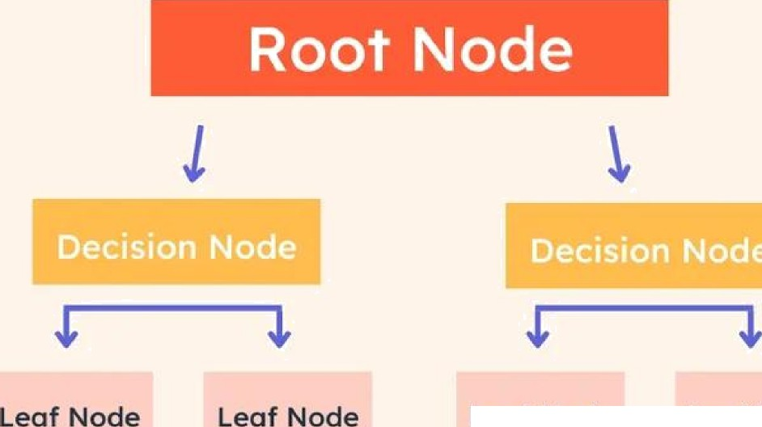
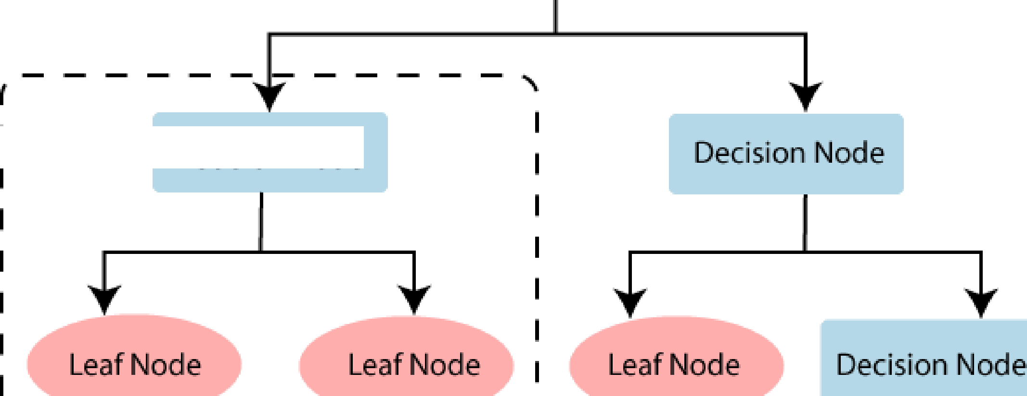
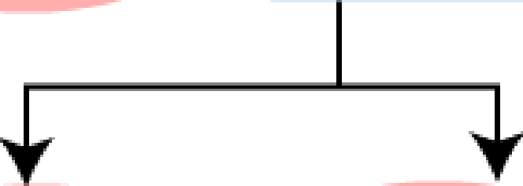
Pictures :
Decision Node
Root Node
I Sub—Tree
Decision Node
Leof Node
Leof Node
Leaf Node
Leaf Node

Slide 16
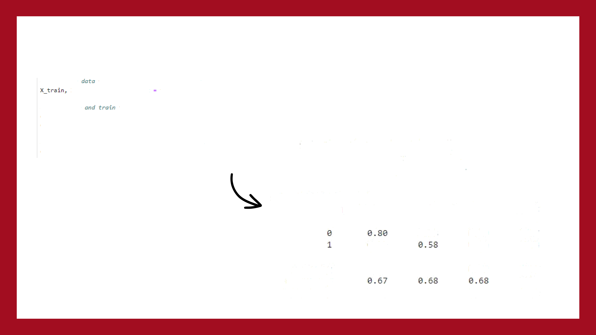

CODE SNIPPET
6 6pL*£ the TzrLo Vrzrtning azzd les zzg se6s X_1est::, y_1 aln y_6es1 t:va?ri_t:est:_sp11t:(X
y, fest:_s1zeW. 2,
andon_st::at:eW2)
Ot_model.fit(X_train, y_train)
# NbAe predictzons uszzg U Oeciszon Tree sam!e dtp ned = dt_nodel.predict(X_test)
Traln Accuracy: 1. £t
Test Accuracy: ä.718å
Classification Report:
 | precision | recall | fl-score | support
 |  | 0.78 | B. 79 | 3437
 |  |  | B.S6 | 1563
accuracy nacra avg |  |  | B.72 | Soee S88B
ue1ghted avg | 0.72 | B.72 | B .72 | S88B

Slide 17

Random Forest
Random Forest is a supervised learning algorithm that combines multiple decision trees to improve the accuracy and robustness of predictions. It is a popular ensemble learning method that is widely used in classiVncation and regression tasks.
Random Forests enhance accuracy and robustness through ensemble learning, resist overVntting, highlight feature impomance, handle missing values, scale well with large datasets, and are versatile for both classiVncation and regression.

Slide 18
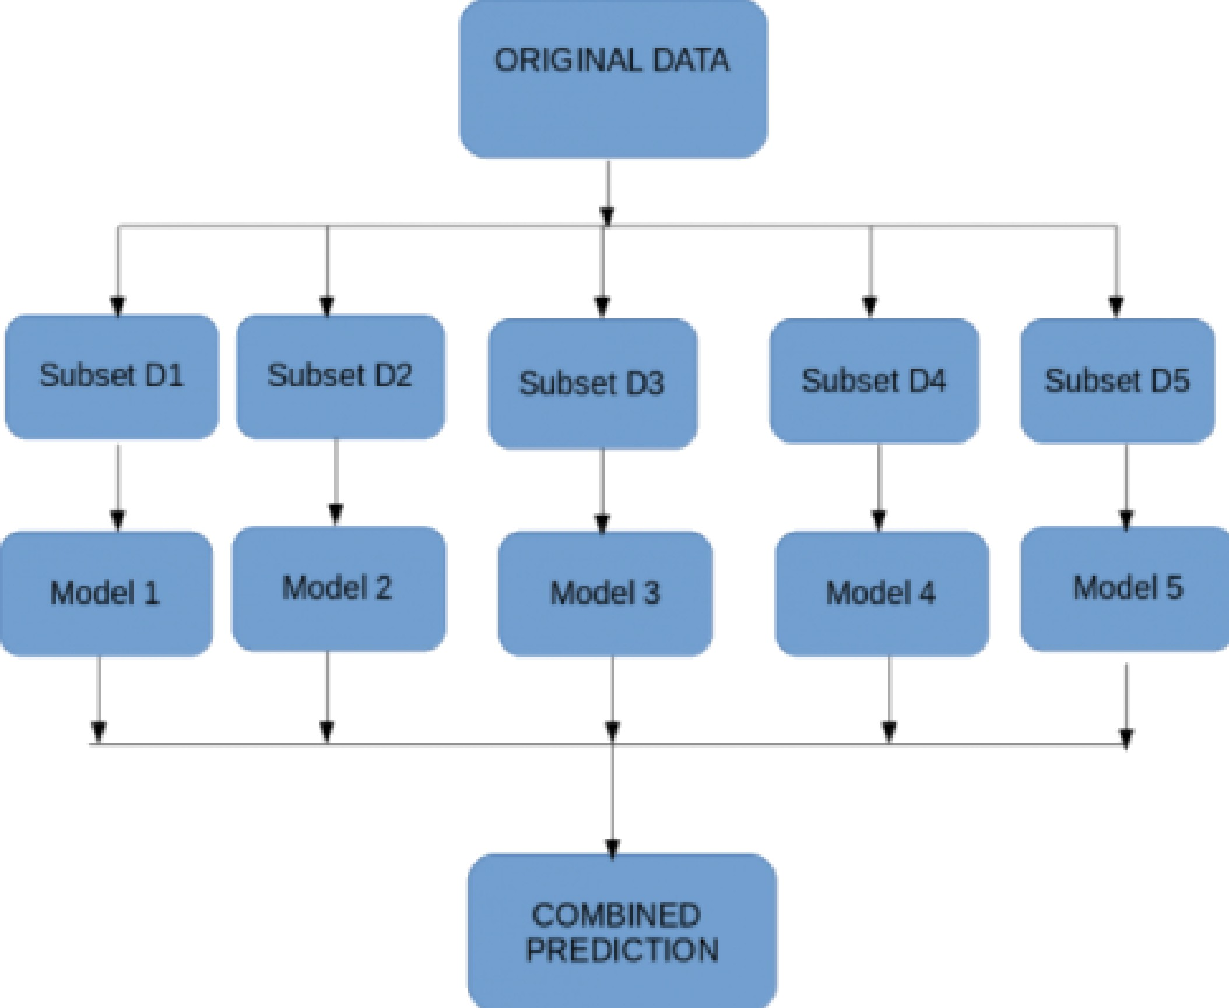

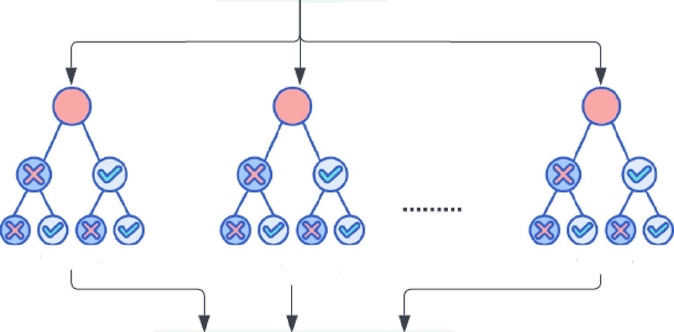

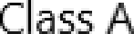
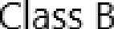

Pict res :
Training Data Instance
Model Training
decision Trees
Class A
Bagging (voting majority)
Model
Testing
Prediction output
Class A

Slide 19

CODE SNIPPET
from sklearn.model selection is ort train test split Arim sklearn.ensemble inport RandomForestClassifier fir<m sklearn.metrics import accuracy score
op( axis•1)
y * d ['target’]
# SpL i tting the data into training and testing sets
X train, X test, y train, y test • train test split(X, y, test size•0.2, random state•42)
rf model - RandcmForestClassifier(n estimators=100, random state-4Z)
rf model.fit(X train, y train)
y pred • rf model.predict(X test)
accuracy - accuracy score(y test, ygred) print(”Accuracy:”, accuracy * 100)
ACCURACY:
86.11111111111111
Training Accuracy: 0.99995
Testing Accuracy: 0.8014
Precision: 0.7953035298178008
Recall: 0.B014
F1 Score: 0.79327952901S0103
ROC AUC ScorR: 0.7371101358126936

Slide 20

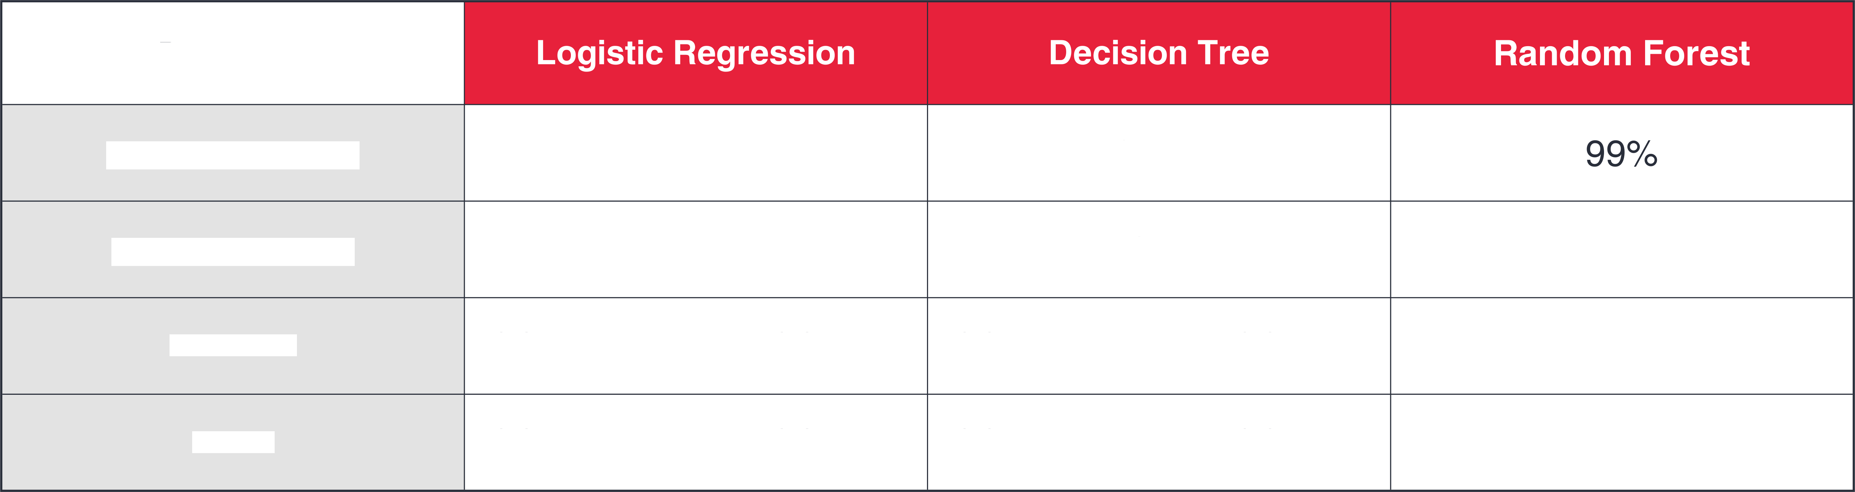
erence :
Parameters
Training Accuracy
95⁰7\
100^{O}/L
Testing Accuracy
82⁰7\
71.8^{O}J
86.2^{O}J
Precision | (0) 84⁰/1 | (1) 69⁰ | (0) 80^{O/} | (1) 55^{O/}
Recall | (0) 96^{O}/L | (1) 31⁰/1 | (0) 79⁰/9 | (1) 56^{O}/L
79.3^{O}/L
80⁰7\
Back to Agenda

Slide 21
om ores
Random
accuracy,
Forests oñer several advantages: they deliver high
resist overfitting, highlight feature importance, and
effectively handle noise and missing values. Additionally, they are versatile and scalable, suitable for both classification and regression tasks. After evaluating all three models, we selected Random Forest due to its superior performance and minimal gap between training and testing accuracy.

Slide 22


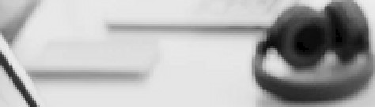

er arameter
y
What is Hyperparameter Tuning ?
p
Hyperparameter Tuning is the process of finding the best settings for a machine learning model to improve its performance. This involves adjusting parameters that control the learning process, like the number of trees in a Random Forest or the learning rate in a neural network. By testing diñerent combinations of these parameters, we identify the ones that yield the best results for our specific data.

Slide 23
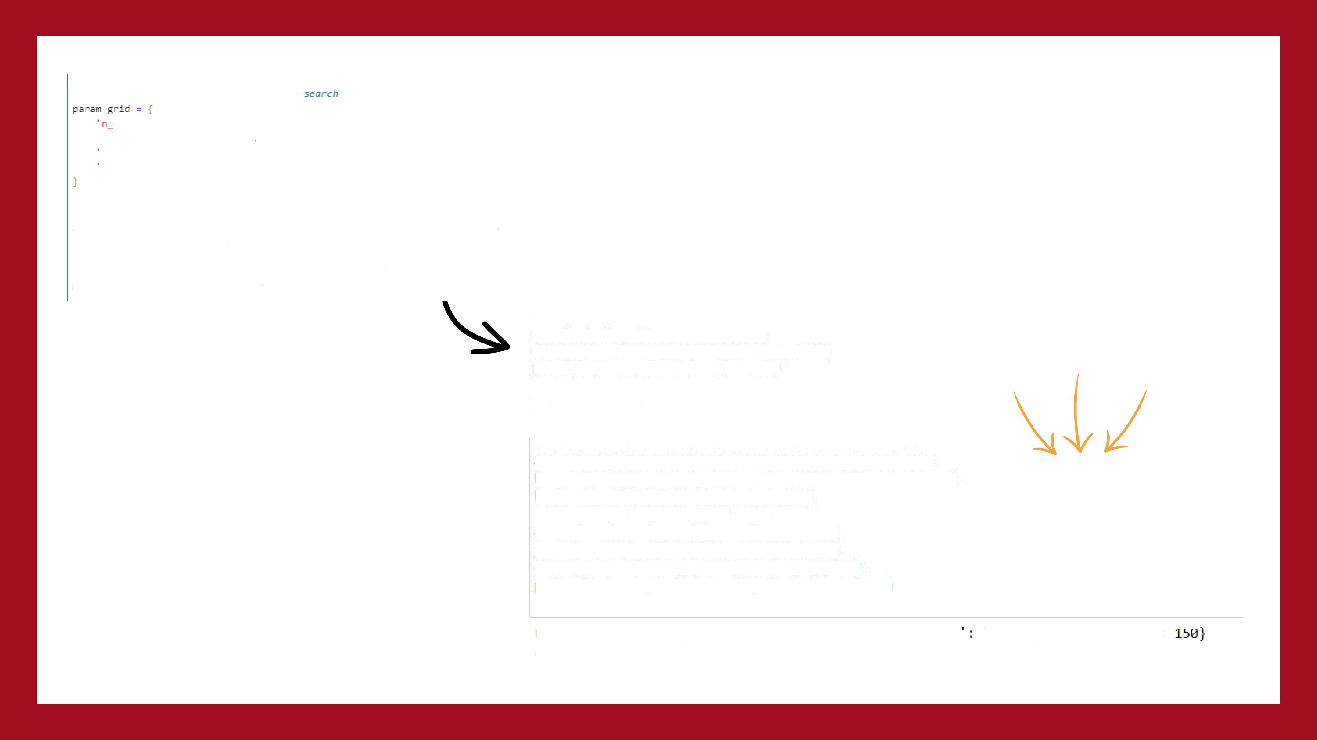
CODE SNIPPET
# Deft ne I:he grid of hypenpanane I:ers to
e st 1oato rs ' : [ 50, 100, 156] ,
' n ax_dept:h ' : [Mon e, I6, 2B ,
min_samples_split ' : [2, 5, l0],
min_s mples_leaf' : [1, 2, 4]
# Zni L:? aL fl ze Cr'ñdSear'chCV
gn1d_s ea re h = G r1d5ea re hCV( e st 1nato n=rf_c1a s s if ie r, par an rid=par an_gr1d,
c z=5, scor1ng= ' a c c ur ac ' n_jobs = -1
# Per or'in gr! d search I:a i nd the best
gn1d_s eare h I i t •{X_t: r a 1n , y_t ra 1n)
hyper'ponome£ens
# CaL cuLat:Eng I:he accuracy s core
aCCUPdCy = accuracy_scDre(y test, y_pred )
pv1n1("Accuracy: ", accuracy ” 16e)
Accuracy: 86.11111111111111
# Training the zode L ivi th the
best hyperparazeters
best rf nodel = RandonForestClassifier(**best params)
best rf model.fit(X train, y train)
# FvoLuot ing I:he nodeL on The tesl: set
y pred = best rf model.predict(X test) accuracy - accuracy scDre(y test, y pred)
print(”Accuracy after tuning:”, accuracy*100)
Best Hyperparameters: {’max depth' : 10,
’max features
'log2',
'n estimators’ :
Accuracy after tuning: 84.72222222222221

Slide 24



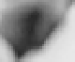
ec
ac me
What is Support Vector Machine ?
*
* Support Vector Machine (SVM) is a powerful supervised learning algorithm used for classification and regression. It finds the optimal hyperplane that best separates classes by maximizing the margin between support vectors. SVM can handle linear and non- linear data using kernel tricks, making it suitable for high-dimensional datasets.

Slide 25
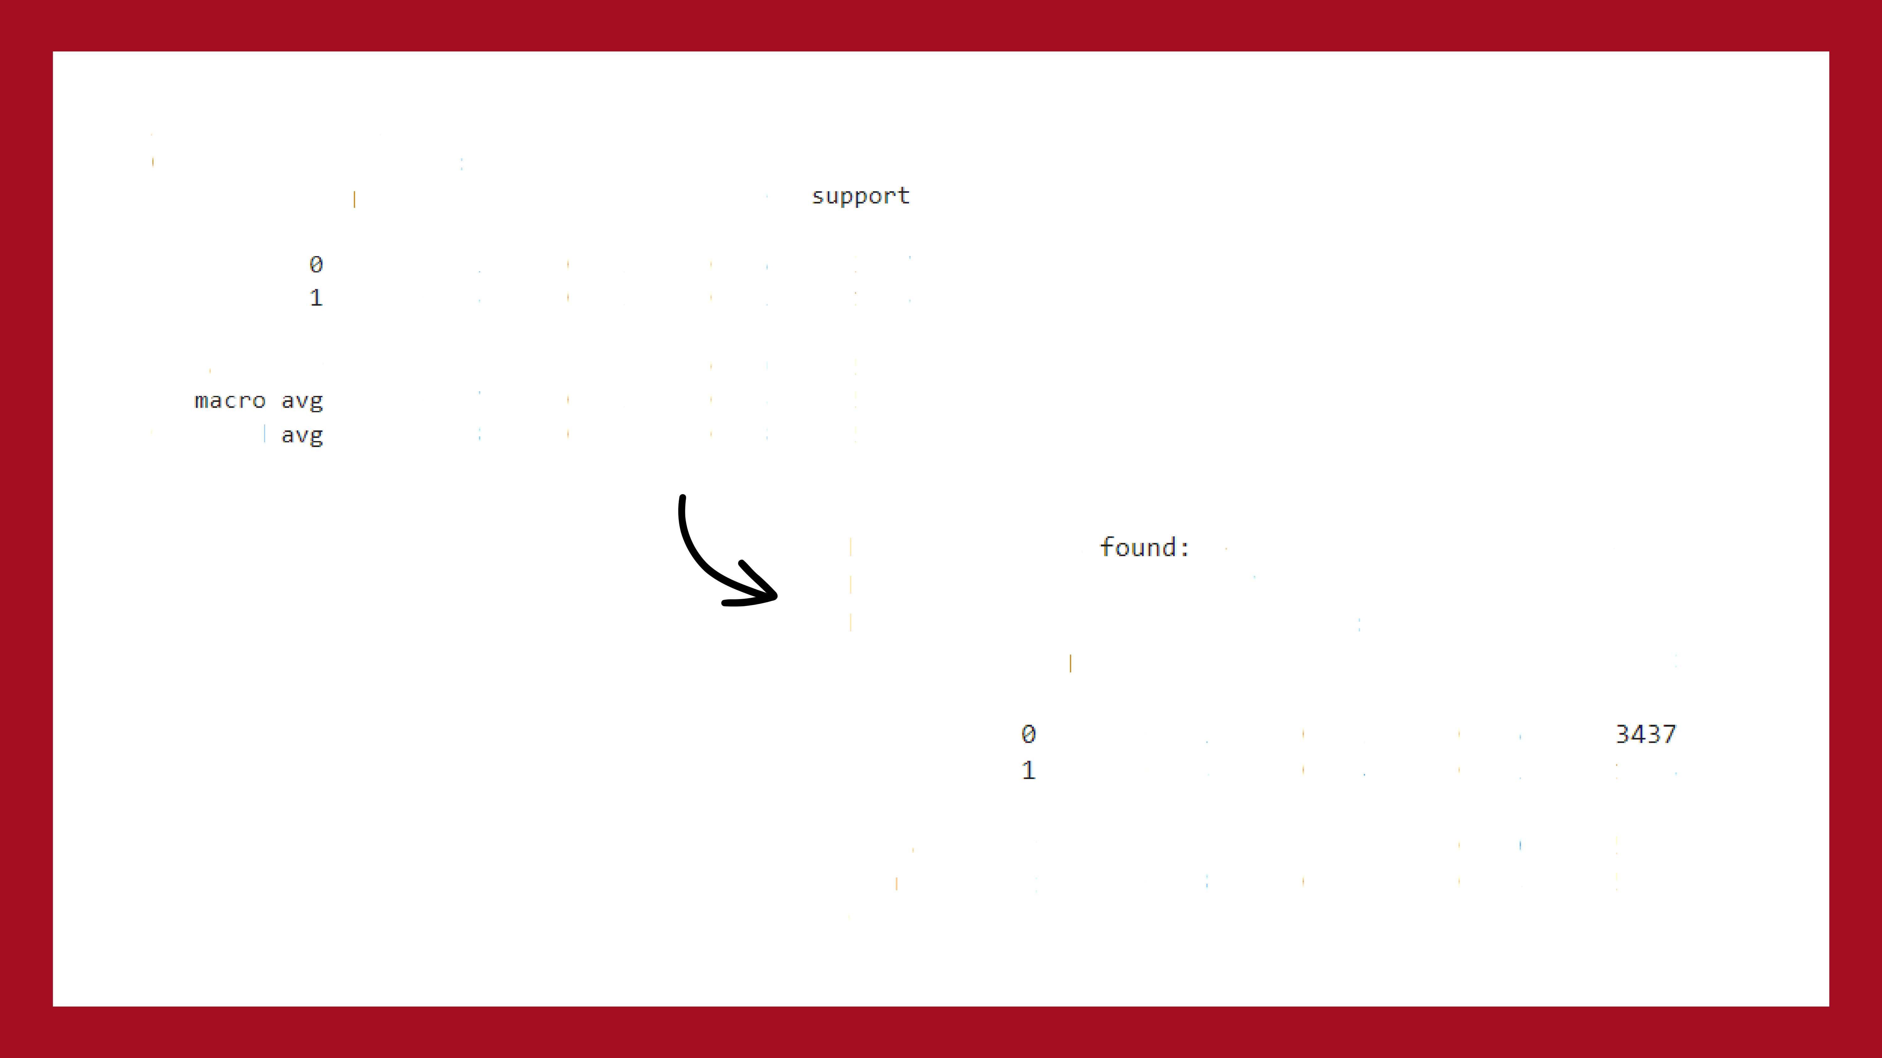


CODE SNIPPET
Accuracy: 0.7912
Elassification | RepDrt: precision | recall | f*-score
 | 0. 81 | B. 91 | B . 86 | 3437
 | 0. 73 | B. 52 | B . 61 | 1563
accuracy |  |  | 0 . 79 | 5606
 | 0.77 | B.72 | 0. 73 | 5606
we1ght ed
0.78
B.79
0 . 78
5606
Best parameters {’C': 1, 'kernel': Best Model Accuracy: 0.797
Best Model Classification Report:
precision recall fl-score
'rbf'}
support
8. 8i 0.74 |  |  | a. S2 0.54 | a. is 0.62 | 1563
accuracy |  | 8 . 88 |  |  | 5606
macro | avg | 0.78 | B.73 | 5606
we1ghted | avg | 0.79 | 0.80 | 5606

Slide 26





usion
What is Confusion Matrix ?
A confusion matrix is a table that evaluates a classification model's performance by showing the counts of true positives, true negatives, false positives, and false negatives. It helps derive metrics like accuracy, precision, recall, and F1 score for a more detailed performance assessment.
y/
”*

Slide 27
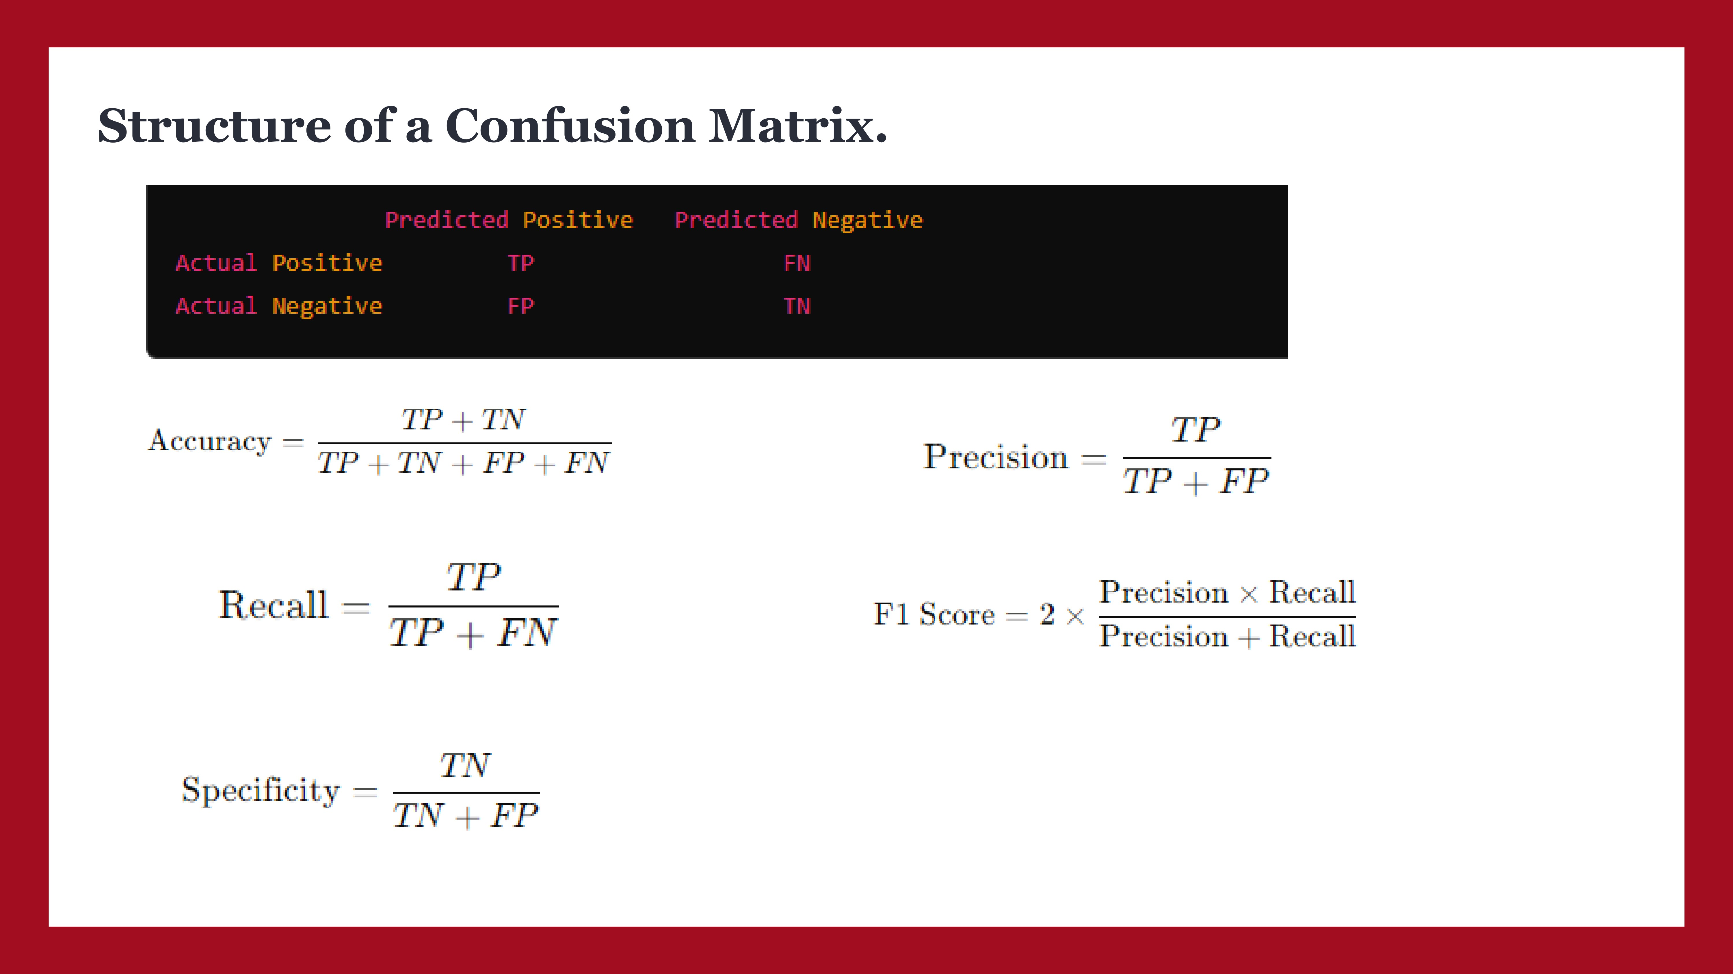

Slide 28
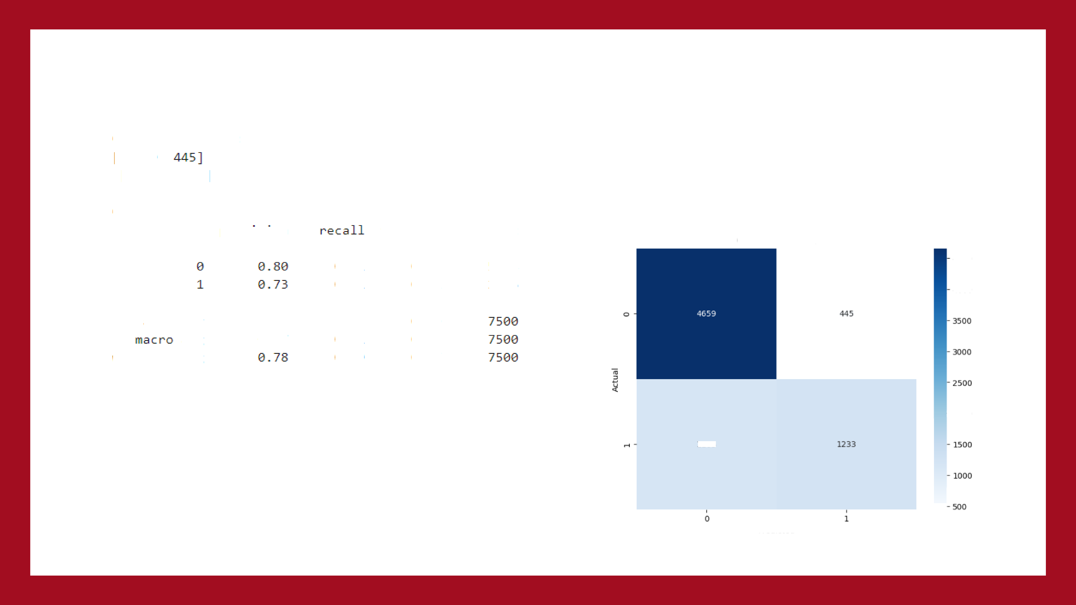
CODE SNIPPET
Confu s żan Fl•st F'1 x:
[ [4059
[ 1103 1 233] ]
CŻasSiflCdtion Report:
pre'c:I s zan
fl-score
support
Confusion Matrix
B . 91
B . 51
0.B5
0. 61
51B4
2396
4500
4OOO
accurdcy
DIU
‹›•e żghted .s vg
0.79
0.73
0.77
0.77
B . 71
B . 79
-2000
1163
Predic ted

Slide 29

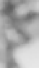
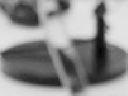


onc usion :
Improved Customer Retention: By accurately predicting which customers are
likely to churn, telecom companies can implement targeted strategies to retain valuable customers, ensuring their satisfaction and loyalty.
Cost Reduction: Preventing churn is more cost-effective than acquiring new
customers. Churn prediction allows for efficient resource allocation and reduces
costs associated with customer attrition.
Enhanced Customer Experience: Understanding customer behavior and preferences enables telecom providers to offer personalized experiences, address concerns proactively, and significantly improve overall satisfaction.
Increased Revenue: Retaining existing customers and maximizing their lifetime
value leads to steady revenue streams and sustainable business growth.
Competitive Advantage: Effective churn prediction and management provide telecom companies with a competitive edge through superior service, tailored offers, and proactive retention initiatives.

